Slide 1
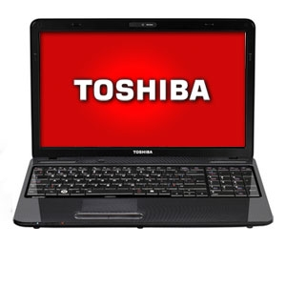
How to Decide Which Computer to Buy
How to Decide Which Computer to Buy
Making Personalized Recommendations
By Andrew Student
February 18, 2011
BBT 9 with Mr. Rich

Slide 2
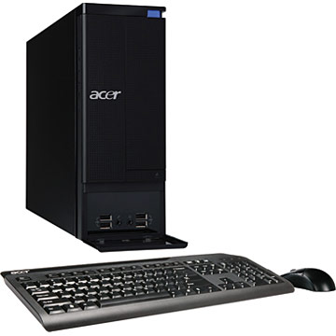
Criteria
Criteria
There are 10 things that must be evaluated when considering a computer purchase.
Brand, Style, Model
Chip / Processor
RAM / Memory
Hard Drive
Operating System
Mac or a version of Windows?
CD / DVD / Blu-ray
Network
Wired ? Wireless?
Monitor / Display
Other
Cards, audio, weight
Price

Slide 3
Criteria
Brand / Style / Model
The Brand is the company that makes the computer.
The Style is either Laptop or Desktop
Sometimes a laptop is called a “notebook”.
The Model can be a name, number, or random series of characters, like “MXb32-LjOP418”.
There are many models from which to choose!

Slide 4
Criteria
Chip / Processor
Chips are usually made by Intel or AMD.
Chip speed is measured in Hertz (Hz), often GHz (gigahertz).
RAM / Memory
RAM helps the computer perform quickly.
Size is measured in Bytes, so look for GB (gigabytes).

Slide 5
…..

Slide 6
Bits & Bytes
When considering these, we must know how to do the math of computers!
(a) A bit can be On (1) or Off (0)
(b) There are 8 bits (b) in one Byte (B)
(c) 1000 B = 1 KB (KiloByte)
(d) 1000 KB = 1 MB (MegaByte)
(e) 1000 MB = 1 GB (GigaByte)
(f) 1000 GB = 1 TB (TeraByte)

Slide 7
recommendations
62-year-old lady
I recommend the Dell Alienware M17x .
It will provide all the gaming experience that a retired person could ever want.
With the 500MB Solid State Drive, no data will be lost when the laptop gets dropped.
The ATI Radeon graphics card sets the industry standard in realistic graphic quality, and the display is a crisp 1900x1200 in High Definition.
The 8GB of RAM will ensure that the all programs are snappy and quick and will load in a flash.
The wired and wireless connections will take care of all of her Internet needs for connecting with her family.
She does still need a high-speed Internet connection to take advantage of all the qualities of an online experience, as this is not included in the price of the laptop.

Slide 8
…..

Slide 9
Credits
Toshiba Laptop image, from the Tiger Direct web site.
http://www.tigerdirect.ca/laptops/toshiba/m9ijkl12.html
Acer Desktop image, from the Staples web site.
http://www.staples.ca/computers/desktops/i.php?9uiou8823&u=no
…

